Slide 1
Older Adult Abuse & Exploitation
Spokane Estate Planning Council
March 21, 2023
Dennis P. Hession, JD, LLM

Slide 2
The Problem of Elder Abuse
Globally 1 in 6 adults age 60+ experience abuse in the community each year. (Rates of abuse in institutions are even higher.)⁶

Slide 3
AGENDA
The Problem of Elder Abuse
Why Older People Are Targeted
The 7 Types of Elder Abuse
What is Being Done to Address the Issue
How You Can Help

Slide 4
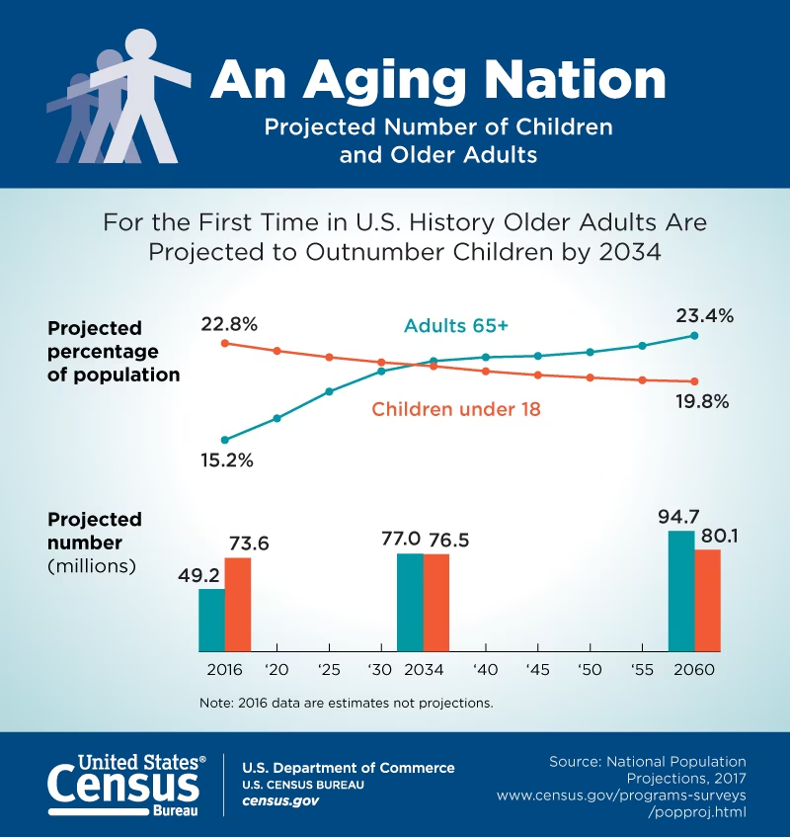
An Ageing Nation
By 2030, all baby boomers will be older than age 65
The global population of people aged 60 years and older will more than double, from 900 million in 2015 to about 2 billion in 2050⁸
By 2034 older people will outnumber children for first time in U.S. history

Slide 5
Elder Abuse: The Facts
Rates of abuse are highest in institutions (i.e. nursing homes / long-term care facilities)
2 in 3 staff reporting that they have committed abuse in the past year⁸
The National Elder Abuse Incidence Study found that only 1 in 14 cases of elder abuse ever comes to the attention of authorities¹
Rates of abuse increased during the COVID-19 pandemic
Abuse can lead to serious physical injuries and long-term psychological consequences⁸
Abuse of older people is predicted to increase as many countries are experiencing rapidly ageing populations⁸

Slide 6
Why Are Older Adults Targeted?
Cognitive & physical decline
Accumulated savings
Lack of comfort with technology
Isolation from family & friends
Vulnerable Population
Ageism
Lack of Awareness of the Problem of Older Person Abuse

Slide 7
The 7 Types of Elder Abuse
Financial Exploitation
Physical Abuse
Sexual Abuse
Emotional / Psychological Exploitation
Abandonment
Neglect
Self-Neglect

Slide 8
Elder Financial Exploitation²
EFE is defined as the illegal or improper use of an older adult’s funds, property or assets
The most common form of elder abuse
At least 10% of older adults in the US are affected each year
Results in >$3B in annual losses to millions of individuals, though the majority of incidents go unreported
Can take the form of Elder Theft & Elder Scams

Slide 9
EFE is a Growing Problem
Suspicious Transactions
62,000 SARs (Suspicious Activity Reports) related to Elder Financial Exploitation reported in 2020
72,000 EFE SARs reported in 2021
COVID-19 worsened the problem
$3.4B
2020
2019
$2.6B

Slide 10
Financial Exploitation²
Elder Theft
Perpetrators often family members & non-family caregivers
Abuse position of trust
Access to information/finances
Commonly forms include:
Exploitation of legal guardianships
Exploitation of power of attorney arrangements
Fraudulent investments
Theft of savings/retirement accounts
Theft of Social Security benefits /other income
Transferring property/assets, or accessing credit cards

Slide 11
Financial Exploitation²
Elder Scams
Perpetrators defraud victims into sending payments or persuading them to share Personal Identifiable Information (PII) under false pretenses
Scammers often outside of the US
Often impersonate:
Government officials
Law enforcement agencies
Technical and support customer representatives
Social media connections
Family/friends
May take money through:
Wire transfers
Prepaid access cards / gift cards
Tracked delivery of cash or cash pickup at the victim’s house
ATM deposits and convertible virtual currency (CVC)

Slide 12
Suspicious Activity Reporting
A Suspicious Activity Report (SAR) is a tool provided under the Bank Secrecy Act (BSA) of 1970 for monitoring suspicious activities that would not ordinarily be flagged under other reports (such as the currency transaction report)³
A financial institution is required to file a SAR if it knows, suspects, or has reason to suspect the use of the financial institution to facilitate criminal activity, including EFE²
The Financial Crimes Enforcement Network (FinCEN) first added an “Elder Financial Exploitation” checkbox to the SAR Form in 2012 and encourages financial institutions to mark the box when filing an EFE-related SAR²

Slide 13
Other Forms of Older Person Abuse
Physical
Sexual
Emotional / Psychological Exploitation
Neglect
Self-Neglect
Abandonment

Slide 14
Physical Abuse “The use of physical force that may result in bodily injury, physical pain, or impairment” ⁷
Signs and symptoms may include:⁷
Bruises, black eyes, welts, lacerations, and rope marks
Bone fractures, broken bones, and skull fractures
Open wounds, cuts, punctures, untreated injuries in various stages of healing
Sprains, dislocations, and internal injuries/bleeding
Broken eyeglasses/frames, physical signs of being subjected to punishment, and signs of being restrained
Laboratory findings of medication overdose or under utilization of prescribed drugs
An elder's report of being hit, slapped, kicked, or mistreated
An elder's sudden change in behavior
The caregiver's refusal to allow visitors to see an elder alone

Slide 15
Sexual Abuse “Nonconsensual contact of any kind with an elderly person or sexual contact with any person incapable of giving consent”⁷
Signs and symptoms:
Bruises around the breasts or genital area
Unexplained venereal disease or genital infections
Unexplained vaginal or anal bleeding
Torn, stained, or bloody underclothing
An elder's report of being sexually assaulted or raped

Slide 16
Emotional or Psychological Abuse
“The infliction of anguish, pain, or distress through verbal or nonverbal acts”⁷; may include:
Verbal assaults, insults, threats, intimidation, humiliation, and harassment
Treating an older person like an infant
Isolating an elderly person from his/her family, friends, or regular activities
Giving an older person the "silent treatment;"
Enforced social isolation
Signs and symptoms of emotional/psychological abuse include:
Being emotionally upset or agitated
Being extremely withdrawn and non communicative or non responsive
Unusual behavior usually attributed to dementia (e.g., sucking, biting, rocking)
An elder's report of being verbally or emotionally mistreated

Slide 17
Abandonment: “Action or inaction by a person or entity with a duty of care for a vulnerable adult that leaves the vulnerable person without the means or ability to obtain necessary food, clothing, shelter, or health care”⁴
Examples:
Leaving an adult alone who cannot obtain help in an emergency
Pattern of showing up late and / or leaving early when providing care
Dropping a dependent adult off at a hospital with no ID
Not showing up and not finding someone else who can provide care⁵

Slide 18
Neglect “The refusal or failure to fulfill any part of a person's obligations or duties to an elder”⁷
May include:
Fiduciary neglect or failure to provide necessary care such as:
Failure to provide necessary care such as food, water, clothing, shelter, personal hygiene, medicine, comfort, personal safety or other essentials
Signs & symptoms:
Dehydration, malnutrition, untreated bed sores, and poor personal hygiene;
Unattended or untreated health problems
Hazardous or unsafe living condition/arrangements (e.g., improper wiring, no heat, or no running water)
Unsanitary and unclean living conditions (e.g. dirt, fleas, lice on person, soiled bedding, fecal/urine smell, inadequate clothing)
An elder's report of being mistreated

Slide 19
Self-Neglect “The behavior of an elderly person that threatens his/her own health or safety”⁷
Often:
A refusal or failure to provide himself/herself with adequate food, water, clothing, shelter, personal hygiene, medication (when indicated), and safety precautions
Signs & symptoms:
Dehydration, malnutrition, untreated or improperly attended medical conditions, and poor personal hygiene
Hazardous or unsafe living conditions/arrangements (e.g., improper wiring, no indoor plumbing, no heat, no running water)
Unsanitary or unclean living quarters (e.g., animal/insect infestation, no functioning toilet, fecal/urine smell)
Inappropriate and/or inadequate clothing, lack of the necessary medical aids (e.g., eyeglasses, hearing aids, dentures)
Grossly inadequate housing or homelessness

Slide 20
Resources

Slide 21
State of WA Statute – Abuse of Vulnerable Adults¹²
The legislature finds and declares that:
(1) Some adults are vulnerable and may be subjected to abuse, neglect, financial exploitation, or abandonment by a family member, care provider, or other person who has a relationship with the vulnerable adult;
(2) A vulnerable adult may be home bound or otherwise unable to represent himself or herself in court or to retain legal counsel in order to obtain the relief available under this chapter or other protections offered through the courts;
(3) A vulnerable adult may lack the ability to perform or obtain those services necessary to maintain his or her well-being because he or she lacks the capacity for consent;
(4) A vulnerable adult may have health problems that place him or her in a dependent position;
(5) The department and appropriate agencies must be prepared to receive reports of abandonment, abuse, financial exploitation, or neglect of vulnerable adults;
(6) The department must provide protective services in the least restrictive environment appropriate and available to the vulnerable adult.

Slide 22
The Washington Adult Guardianship Law¹³
Washington did away with the distinction of Guardian of the Person and Guardian of the Estate
New law provides potential wards with greater opportunity to retain their independence and decision-making ability to the extent of their ability
There must be a significant risk of harm to the adult unless a guardian is appointed
A court may appoint a guardian for an adult when the adult is unable to meet their basic needs for physical health, safety, or self-care
The court would have to determine that the adult is unable to receive and evaluate information or make or communicate decisions, even with support or assistance
If the adult’s needs can be met in other ways, the court may not appoint a guardian
Less Restrictive Alternatives & Protective Arrangements
Power of Attorney
Technological Assistance
Supported Decision-Making Agreement
Protective Arrangement

Slide 23
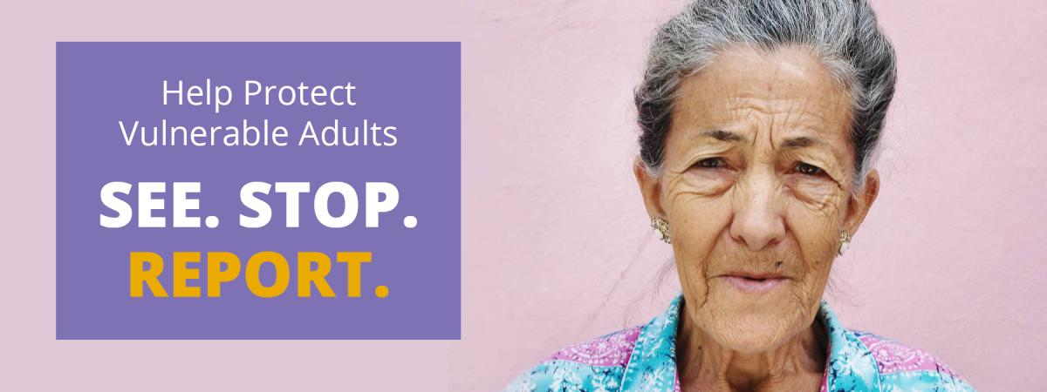
Adult Protective Services (APS)ꝰ
Receives & investigates allegations of abuse in older persons’ own homes & in facilities that are licensed by the Department of Health and Social Services
Investigator will make unannounced visit, interview the victim (in private), the alleged perpetrator & others who may have information
APS will report to law enforcement if a crime is suspected, or file for an injunction if access is denied
May offer protective services as soon as a need is determined
In calendar year 2020 (January 2020 – December 2020) the Department received 65,106 reports of suspected abuse, neglect, self-neglect, financial exploitation, and abandonment of vulnerable adults
Partners: Law Enforcement Agencies, State Ombudsman, Area Agencies on ageing, Department of Health
Oversight: Centers for Medicare and Medicaid Services (CMS), State Auditor’s Office, APS Quality Assurance Monitoring Process

Slide 24
Reporting Elder Abuse to DSHS
Reporters are encouraged to report online
All reports screened by Adult Protective Services and / or Residential Care Services
You do not need to give your name or provide proof
Unless there is a court action, law enforcement has been called in, or you agree, your identity is confidential
The report will be triaged and prioritized for investigation. A DSHS staff member may contact the reporter for more information. All reports are confidential
Report online:
https://fortress.wa.gov/dshs/altsaapps/OCR/publicOCR.PubRptInputReporterInformation.executeLoad.action
Contact Adult Protective Services for reports on allegations of abuse, abandonment, neglect, self-neglect and financial exploitation of vulnerable adults living in the community and in facilities:
1-877-734-6277
(TTY) 1-833-866-5595
Contact the Complaint Resolution Unit to report concerns regarding a person living in a facility (e.g. a nursing home, adult family home, assisted living, enhanced services, intermediate care for individuals with intellectual disabilities) or receiving supported living services:
1-800-562-6078
(TTY) 1-800-737-7931
Unless there is a court action, law enforcement has been called in, or you agree, your identity is confidential

Slide 25
Local Initiatives – Spokane Police Department
Special Investigation Unit covers abuse of vulnerable populations, including children and older adults
Investigate every unattended death in the City of Spokane (in the community and in institutions)
Receive reports and referrals from Adult Protective Services, Crime Check, individuals and long-term care facilities
Physical abuse cases treated as assaults
Scams comprise 90% of the calls
Caregiver or family members
Elderly dating services
Investigate but hard to prove, often because of lack of information
Special acknowledgement to Julie Humphreys, City of Spokane Public Communications Manager

Slide 26
The United Nations Decade of Healthy Ageing
The problem of older person abuse receives little attention
The WHO sees this as a global public health crisis & is leading a global collaboration called “The United Nations Decade of Healthy Ageing 2021 – 2030 ”
It’s a global collaboration among governments, civil society, international agencies, professionals, academia, the media and the private sector to improve the lives of older people, their families and the communities in which they live
You can participated in the Decade’s goals through direct action, partnering with others, and by participating in the Healthy Ageing Collaborative

Slide 27
The Decade of Healthy Ageing’s 5 Priorities
Combat Ageism
1
Generate Better Data (Prevalence, Risk & Protective Factors)
2
Develop & Scale up Cost-Effective Solutions
3
Make an Investment Case
4
Raise Funds
5

Slide 28
Get Involved
Spread awareness
World Elder Abuse Awareness Day is June 15th
Learn about the WHO’s Decade of Healthy Ageing & read about or join The Healthy Ageing Collaborative - https://www.decadeofhealthyageing.org
Educate people in our communities about how to recognize and intervene in instances of elder abuse: http://eldermistreatment.usc.edu/wp-content/uploads/2018/03/NCEA_12things_508-1.pdf

Slide 29
Learn the Signs of Elder Abuse & Share Them

Slide 30
References
1) Acierno, R., Hernandez, M.A., Amstadter, A.B., Resnick, H.S., Steve, K., Muzzy, W., & Kilpatrick, D.G. (2010). Prevalence and correlates of emotional, physical, sexual, and financial abuse and potential neglect in the United States: The national elder mistreatment study. American Journal of Public Health, 100(2), 292-297. doi:10.2105/AJPH.2009.163089
2) https://www.fincen.gov/sites/default/files/advisory/2022-06-15/FinCEN%20Advisory%20Elder%20Financial%20Exploitation%20FINAL%20508.pdf
3) https://www.investopedia.com/terms/s/suspicious-activity-report.asp
4) https://app.leg.wa.gov/rcw/default.aspx?cite=74.34.020
5) http://www.dhs.state.or.us/spd/tools/cm/aps/community/neglect_aband.pdf
6) https://www.who.int/publications/i/item/9789240052550
7) https://ncea.acl.gov/Suspect-Abuse/Abuse-Types.aspx
8) https://www.who.int/news-room/fact-sheets/detail/abuse-of-older-people
9) https://www.dshs.wa.gov/altsa/about-us
10) https://app.leg.wa.gov/RCW/default.aspx?cite=11.130.265&pdf=true
11) https://app.leg.wa.gov/RCW/default.aspx?cite=11.130.580&pdf=true
12) https://app.leg.wa.gov/rcw/default.aspx?cite=74.34.005
13) https://www.courts.wa.gov/guardianportal/guardianship2022/content/pdf/General%20Information%20Sheet%20-%20New%20Guardianship%20Law%20RCW%2011.130%20effective%20January%201,%202022.pdf

